Slide 1
Brief of GPU&CUDA
Chun-Yuan Lin

Slide 2
What is GPU?
Graphics Processing Units
GPU
115/11/08

Slide 3
The Challenge
Render infinitely complex scenes
And extremely high resolution
In 1/60th of one second
Luxo Jr. 1985 took 2-3 hours per frame to render on a Cray-1 supercomputer
Today we can easily render that in 1/30th of one second
Over 300,000x faster
Still not even close to where we need to be… but look how far we’ve come!
© David Kirk/NVIDIA and Wen-mei W. Hwu, 2007
ECE 498AL1, University of Illinois, Urbana-Champaign
© David Kirk/NVIDIA and Wen-mei W. Hwu, 2007
ECE 498AL, University of Illinois, Urbana-Champaign

Slide 4

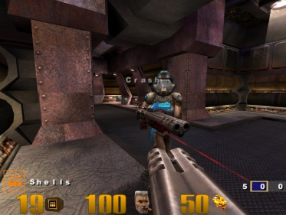
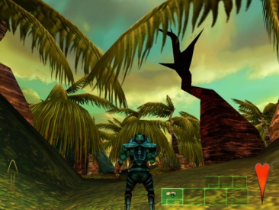



PC/DirectX Shader Model Timeline
DirectX 6
DirectX 7
DirectX 8
DirectX 9
DirectX 9.0c
DirectX 5
Multitexturing
T&L TextureStageState
SM 1.x
SM 2.0
SM 3.0
Riva 128
Riva TNT
GeForce 256
GeForce 3
Cg
GeForceFX
GeForce 6
1998
1999
2000
2001
2002
2003
2004
Half-Life
Quake 3
Giants
Halo
Far Cry
UE3
GPU
© David Kirk/NVIDIA and Wen-mei W. Hwu, 2007
ECE 498AL1, University of Illinois, Urbana-Champaign
115/11/08

Slide 5
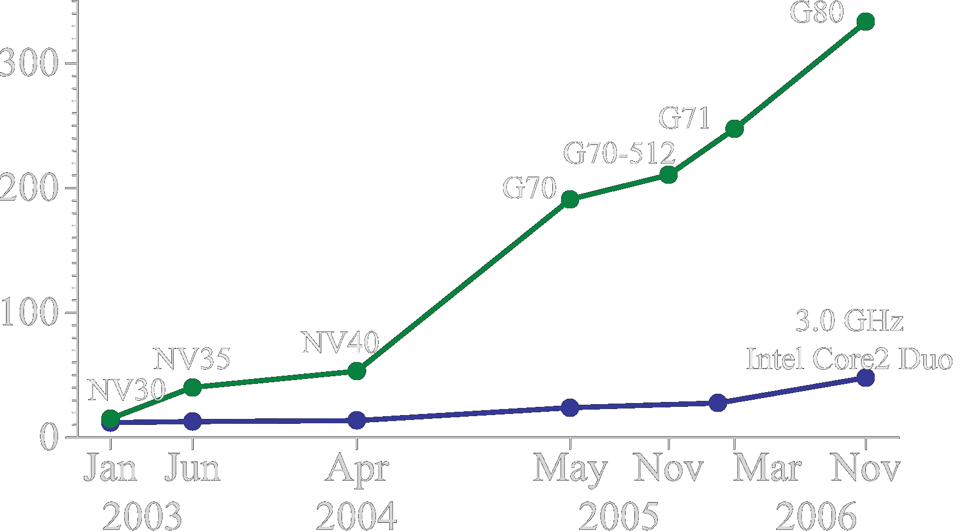
Why Massively Parallel Processor
A quiet revolution and potential build-up
  Calculation: 367 GFLOPS vs. 32 GFLOPS
  Memory Bandwidth: 86.4 GB/s vs. 8.4 GB/s
  Until last year, programmed through graphics API
  GPU in every PC and workstation – massive volume and potential impact
GFLOPS
G80 = GeForce 8800 GTX
G71 = GeForce 7900 GTX
G70 = GeForce 7800 GTX
NV40 = GeForce 6800 Ultra
NV35 = GeForce FX 5950 Ultra
NV30 = GeForce FX 5800
GPU
© David Kirk/NVIDIA and Wen-mei W. Hwu, 2007
ECE 498AL1, University of Illinois, Urbana-Champaign
115/11/08

Slide 6
GeForce 8800
16 highly threaded SM’s, >128 FPU’s, 367 GFLOPS, 768 MB DRAM, 86.4 GB/S Mem BW, 4GB/S BW to CPU
Host
Input Assembler
Thread Execution Manager
Parallel Data
Cache
Parallel Data
Cache
Parallel Data
Cache
Parallel Data
Cache
Parallel Data
Cache
Parallel Data
Cache
Parallel Data
Cache
Parallel Data
Cache
Texture
Texture
Texture
Texture
Texture
Texture
Texture
Texture
Texture
Load/store
Load/store
Load/store
Load/store
Load/store
Load/store
© David Kirk/NVIDIA and Wen-mei W. Hwu, 2007
ECE 498AL1, University of Illinois, Urbana-Champaign
Global Memory

Slide 7
G80 Characteristics
367 GFLOPS peak performance (25-50 times of current high-end microprocessors)
265 GFLOPS sustained for apps such as VMD
Massively parallel, 128 cores, 90W
Massively threaded, sustains 1000s of threads per app
30-100 times speedup over high-end microprocessors on scientific and media applications: medical imaging, molecular dynamics
“I think they're right on the money, but the huge performance differential (currently 3 GPUs ~= 300 SGI Altix Itanium2s) will invite close scrutiny so I have to be careful what I say publically until I triple check those numbers.”
-John Stone, VMD group, Physics UIUC
© David Kirk/NVIDIA and Wen-mei W. Hwu, 2007
ECE 498AL1, University of Illinois, Urbana-Champaign

Slide 8
Objective
To understand the major factors that dictate performance when using GPU as an compute accelerator for the CPU
  The feeds and speeds of the traditional CPU world
  The feeds and speeds when employing a GPU
  To form a solid knowledge base for performance programming in modern GPU’s
Knowing yesterday, today, and tomorrow
  The PC world is becoming flatter
  Outsourcing of computation is becoming easier…
© David Kirk/NVIDIA and Wen-mei W. Hwu, 2007
ECE 498AL1, University of Illinois, Urbana-Champaign

Slide 9
Future Apps Reflect a Concurrent World
Exciting applications in future mass computing market have been traditionally considered “supercomputing applications”
  Molecular dynamics simulation, Video and audio coding and manipulation, 3D imaging and visualization, Consumer game physics, and virtual reality products
  These “Super-apps” represent and model physical, concurrent world
Various granularities of parallelism exist, but…
  programming model must not hinder parallel implementation
  data delivery needs careful management
© David Kirk/NVIDIA and Wen-mei W. Hwu, 2007
ECE 498AL1, University of Illinois, Urbana-Champaign
Notes:
Do not go over all of the different applications. Let them read them instead.

Slide 10
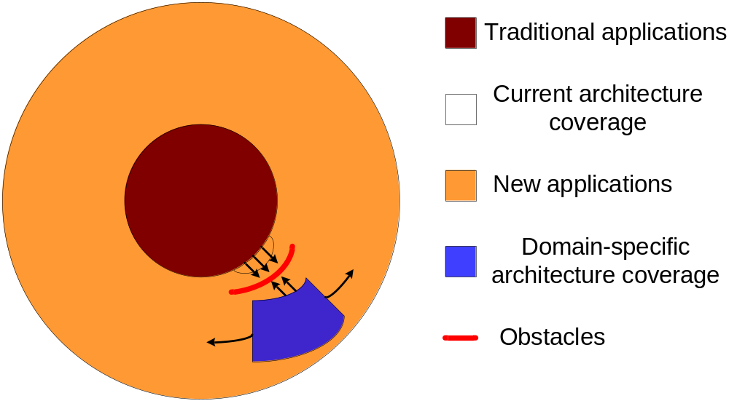

Stretching from Both Ends for the Meat
New GPU’s cover massively parallel parts of applications better than CPU
Attempts to grow current CPU architectures “out” or domain-specific architectures “in” lack success
  Using a strong combination on apps a compelling idea
  CUDA
© David Kirk/NVIDIA and Wen-mei W. Hwu, 2007
ECE 498AL1, University of Illinois, Urbana-Champaign
Notes:
This leads to memory wall: Why we can’t transparently extend out the current model to the future application space: memory wall. How does the meaning of the memory wall change as we transition into architectures that target the super-application space.
Lessons learned from Itanium

Slide 11
Bandwidth –
Gravity of Modern Computer Systems
The Bandwidth between key components ultimately dictates system performance
  Especially true for massively parallel systems processing massive amount of data
  Tricks like buffering, reordering, caching can temporarily defy the rules in some cases
  Ultimately, the performance goes falls back to what the “speeds and feeds” dictate
© David Kirk/NVIDIA and Wen-mei W. Hwu, 2007
ECE 498AL1, University of Illinois, Urbana-Champaign

Slide 12
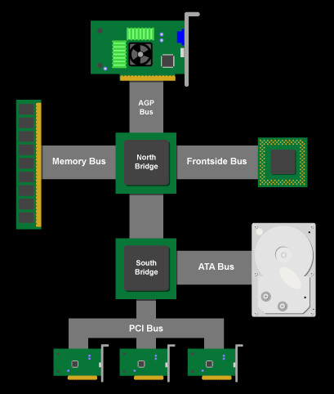
Classic PC architecture
Northbridge connects 3 components that must be communicate at high speed
  CPU, DRAM, video
  Video also needs to have 1st-class access to DRAM
  Previous NVIDIA cards are connected to AGP, up to 2 GB/s transfers
Southbridge serves as a concentrator for slower I/O devices
CPU
Core Logic Chipset
© David Kirk/NVIDIA and Wen-mei W. Hwu, 2007
ECE 498AL1, University of Illinois, Urbana-Champaign

Slide 13
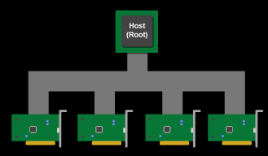
PCI Bus Specification
Connected to the southBridge
  Originally 33 MHz, 32-bit wide, 132 MB/second peak transfer rate
  More recently 66 MHz, 64-bit, 512 MB/second peak
  Upstream bandwidth remain slow for device (256MB/s peak)
  Shared bus with arbitration
    Winner of arbitration becomes bus master and can connect to CPU or DRAM through the southbridge and northbridge
© David Kirk/NVIDIA and Wen-mei W. Hwu, 2007
ECE 498AL1, University of Illinois, Urbana-Champaign

Slide 14
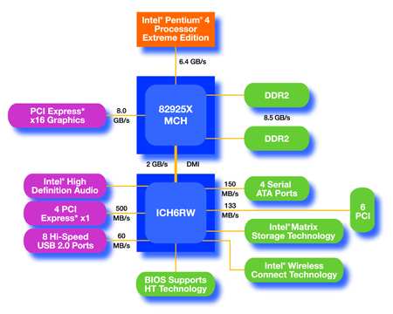
An Example of Physical Reality Behind CUDA
CPU
(host)
GPU w/
local DRAM
(device)
Northbridge handles “primary” PCIe to video/GPU and DRAM.
  PCIe x16 bandwidth at 8 GB/s (4 GB each direction)
GPU
© David Kirk/NVIDIA and Wen-mei W. Hwu, 2007
ECE 498AL1, University of Illinois, Urbana-Champaign
115/11/08

Slide 15
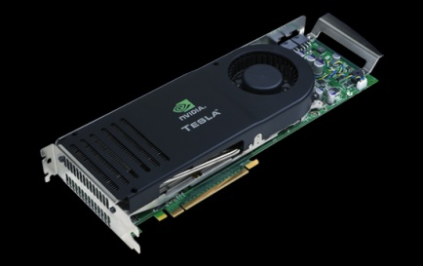
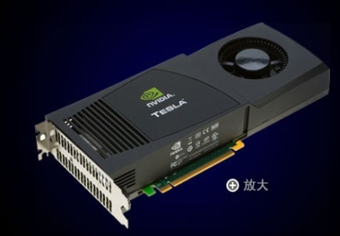
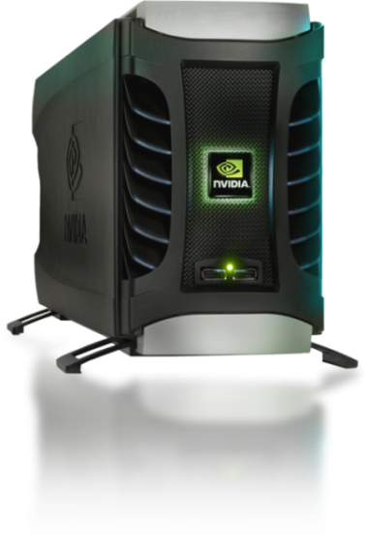
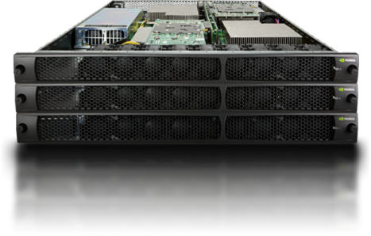
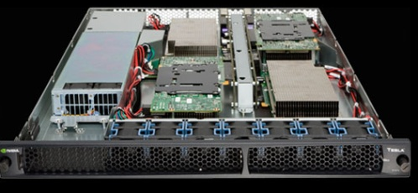
Parallel Computing on a GPU
NVIDIA GPU Computing Architecture
  Via a separate HW interface
  In laptops, desktops, workstations, servers
  G80 to G200
8-series GPUs deliver 50 to 200 GFLOPS
on compiled parallel C applications
Programmable in C with CUDA tools
Multithreaded SPMD model uses application
data parallelism and thread parallelism
Tesla C870
Tesla C1060
1T GFLOPS
Tesla D870
Tesla S870
Tesla S1070
© David Kirk/NVIDIA and Wen-mei W. Hwu, 2007
ECE 498AL1, University of Illinois, Urbana-Champaign

Slide 16
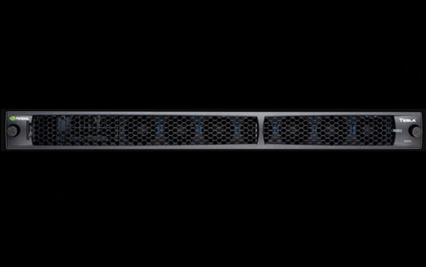
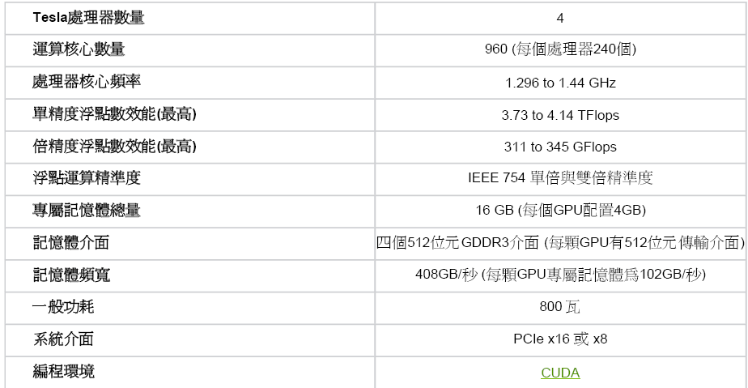
TESLA S1070
NVIDIA® Tesla™ S1070 : 4 teraflop
1U system。

Slide 17

What is GPGPU ?
General Purpose computation using GPU in applications other than 3D graphics
  GPU accelerates critical path of application
Data parallel algorithms leverage GPU attributes
  Large data arrays, streaming throughput
  Fine-grain SIMD parallelism
  Low-latency floating point (FP) computation
Applications – see //GPGPU.org
  Game effects (FX) physics, image processing
  Physical modeling, computational engineering, matrix algebra, convolution, correlation, sorting
GPU
© David Kirk/NVIDIA and Wen-mei W. Hwu, 2007
ECE 498AL1, University of Illinois, Urbana-Champaign
115/11/08
Notes:
Mark Harris, of Nvidia, runs the gpgpu.org website

Slide 18
DirectX 5 / OpenGL 1.0 and Before
Hardwired pipeline
  Inputs are DIFFUSE, FOG, TEXTURE
  Operations are SELECT, MUL, ADD, BLEND
  Blended with FOG
    RESULT = (1.0-FOG)*COLOR + FOG*FOGCOLOR
Example Hardware
  RIVA 128, Voodoo 1, Reality Engine, Infinite Reality
No “ops”, “stages”, programs, or recirculation
© David Kirk/NVIDIA and Wen-mei W. Hwu, 2007
ECE 498AL1, University of Illinois, Urbana-Champaign

Slide 19
The 3D Graphics Pipeline
Application
Host
Scene Management
Geometry
Rasterization
Frame
Buffer
Memory
GPU
Pixel Processing
ROP/FBI/Display
© David Kirk/NVIDIA and Wen-mei W. Hwu, 2007
ECE 498AL1, University of Illinois, Urbana-Champaign

Slide 20
The GeForce Graphics Pipeline
Matt
20
Host
Vertex Control
Vertex
Cache
VS/T&L
Triangle Setup
Raster
Frame
Buffer
Memory
Texture
Cache
Shader
ROP
FBI
© David Kirk/NVIDIA and Wen-mei W. Hwu, 2007
ECE 498AL1, University of Illinois, Urbana-Champaign

Slide 21
Feeding the GPU
GPU accepts a sequence of commands and data
  Vertex positions, colors, and other shader parameters
  Texture map images
  Commands like “draw triangles with the following vertices until you get a command to stop drawing triangles”.
Application pushes data using Direct3D or OpenGL
GPU can pull commands and data from system memory or from its local memory
© David Kirk/NVIDIA and Wen-mei W. Hwu, 2007
ECE 498AL1, University of Illinois, Urbana-Champaign

Slide 22


CUDA
“Compute Unified Device Architecture”
General purpose programming model
  GPU = dedicated super-threaded, massively data parallel co-processor
Targeted software stack
  Compute oriented drivers, language, and tools
Driver for loading computation programs into GPU
  Standalone Driver - Optimized for computation
  Interface designed for compute - graphics free API
  Guaranteed maximum download & readback speeds
  Explicit GPU memory management
GPU
© David Kirk/NVIDIA and Wen-mei W. Hwu, 2007
ECE 498AL1, University of Illinois, Urbana-Champaign
115/11/08

Slide 23
CUDA Programming Model:
A Highly Multithreaded Coprocessor
The GPU is viewed as a compute device that:
  Is a coprocessor to the CPU or host
  Has its own DRAM (device memory)
  Runs many threads in parallel
Data-parallel portions of an application are executed on the device as kernels which run in parallel on many threads
Differences between GPU and CPU threads
  GPU threads are extremely lightweight
    Very little creation overhead
  GPU needs 1000s of threads for full efficiency
    Multi-core CPU needs only a few
GPU
© David Kirk/NVIDIA and Wen-mei W. Hwu, 2007
ECE 498AL1, University of Illinois, Urbana-Champaign
115/11/08

Slide 24
Thread Batching: Grids and Blocks
A kernel is executed as a grid of thread blocks
  All threads share data memory space
A thread block is a batch of threads that can cooperate with each other by:
  Synchronizing their execution
  Efficiently sharing data through a low latency shared memory
Two threads from two different blocks cannot cooperate
Host
Device
Grid 1
Kernel 1
Block
(0, 0)
Block
(1, 0)
Block
(2, 0)
Block
(0, 1)
Block
(1, 1)
Block
(2, 1)
Grid 2
Kernel 2
Block (1, 1)
Thread
(0, 0)
Thread
(1, 0)
Thread
(2, 0)
Thread
(3, 0)
Thread
(4, 0)
Thread
(0, 1)
Thread
(1, 1)
Thread
(2, 1)
Thread
(3, 1)
Thread
(4, 1)
Thread
(0, 2)
Thread
(1, 2)
Thread
(2, 2)
Thread
(3, 2)
Thread
(4, 2)
GPU
© David Kirk/NVIDIA and Wen-mei W. Hwu, 2007
ECE 498AL1, University of Illinois, Urbana-Champaign
115/11/08
Courtesy: NDVIA

Slide 25
CUDA Device Memory Space Overview
Each thread can:
  R/W per-thread registers
  R/W per-thread local memory
  R/W per-block shared memory
  R/W per-grid global memory
  Read only per-grid constant memory
  Read only per-grid texture memory
(Device) Grid
Block (0, 0)
Block (1, 0)
Shared Memory
Shared Memory
Registers
Registers
Registers
Registers
Thread (0, 0)
Thread (1, 0)
Thread (0, 0)
Thread (1, 0)
Local
Memory
Local
Memory
Local
Memory
Local
Memory
The host can R/W global, constant, and texture memories
Host
Global
Memory
Constant
Memory
Texture
Memory
GPU
© David Kirk/NVIDIA and Wen-mei W. Hwu, 2007
ECE 498AL1, University of Illinois, Urbana-Champaign
115/11/08
Notes:
Global, constant, and texture memory spaces are persistent across kernels called by the same application.

Slide 26
Global, Constant, and Texture Memories
(Long Latency Accesses)
Global memory
  Main means of communicating R/W Data between host and device
  Contents visible to all threads
Texture and Constant Memories
  Constants initialized by host
  Contents visible to all threads
(Device) Grid
Block (0, 0)
Block (1, 0)
Shared Memory
Shared Memory
Registers
Registers
Registers
Registers
Thread (0, 0)
Thread (1, 0)
Thread (0, 0)
Thread (1, 0)
Local
Memory
Local
Memory
Local
Memory
Local
Memory
Host
Global
Memory
Constant
Memory
Texture
Memory
GPU
© David Kirk/NVIDIA and Wen-mei W. Hwu, 2007
ECE 498AL1, University of Illinois, Urbana-Champaign
115/11/08
Courtesy: NDVIA

Slide 27
What is Behind such an Evolution?
The GPU is specialized for compute-intensive, highly data parallel computation (exactly what graphics rendering is about)
  So, more transistors can be devoted to data processing rather than data caching and flow control
Control
ALU
ALU
ALU
ALU
Cache
CPU
GPU
DRAM
DRAM
GPU
© David Kirk/NVIDIA and Wen-mei W. Hwu, 2007
ECE 498AL1, University of Illinois, Urbana-Champaign
115/11/08

Slide 28
Resource
CUDA ZONE:
http://www.nvidia.com.tw/object/cuda_home_tw.html#
CUDA Course: http://www.nvidia.com.tw/object/cuda_university_courses_tw.html

